Slide 1
Mario Bros: Group project Team #include <iostream>
Created By:
Mohsen
Evan
Jiabei
Chandler

Slide 2
Mohsen Soltani
Hometown: Trinity, NC
Major: Computer Science/Game Design
Interesting Fact: Born to Iranian and Nicaraguan Parents
Role: Working on Sprite Class, Collision boxes

Slide 3
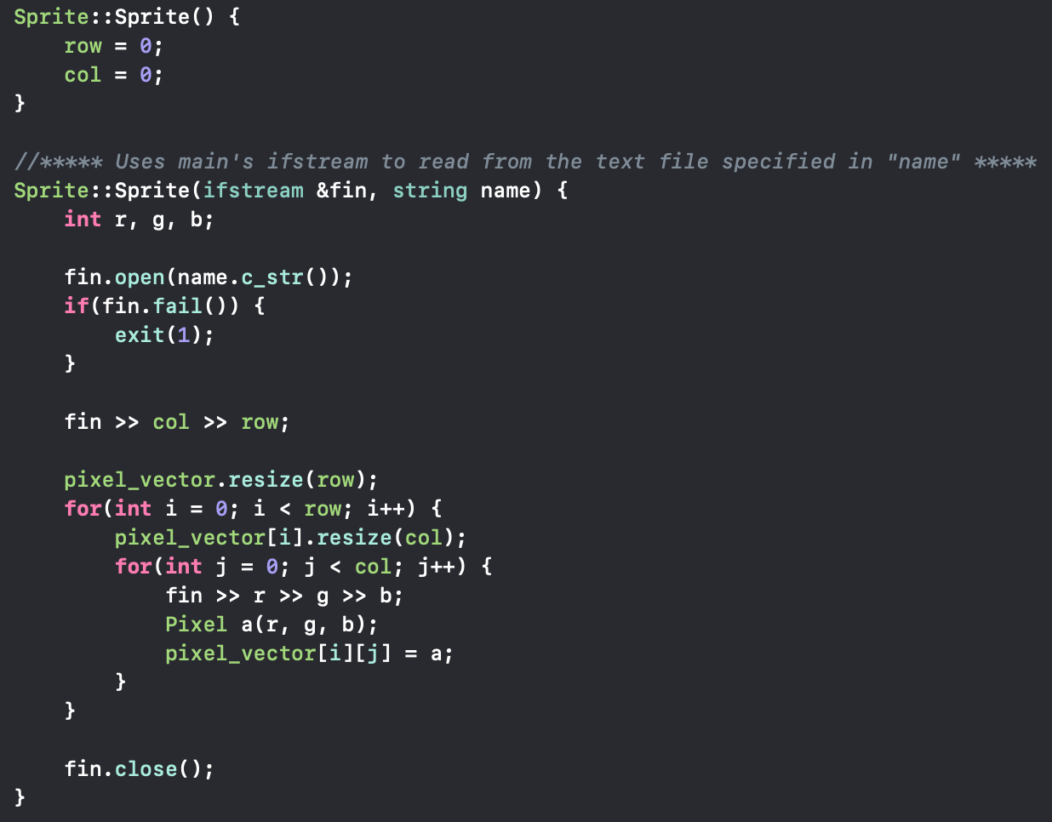
Basic Sprite Structure

Slide 4
Chandler Autrey
Hometown : Houston, Tx
Major: Computer Science
Interesting Fact: Likes Dragon Ball Z
Role: Enemy movement and design of fighter flies and slip ice

Slide 5
Evan Berryman
Hometown: Spring, TX
Major: Computer Science (Game Design)
Interesting fact: has a black belt
Role: Shellcreeper and Sidestepper movement and design

Slide 6
Jiabei He
Hometown: Xi’an, China
Major: Computer Science
Interesting Fact: never give up
Role: Mario movement and design

Slide 7
HyunDo Song
Hometown: Seoul, South Korea
Major: Computer Science/Game Design
Interesting Fact: Has lived in South Korea, California, and Alaska
Role: Collab on Sprite Class and Platform/Level design

Slide 8
Yutong Zhang
Hometown: Beijing, China
Major: Computer Science
Role: Sound class design and implementation

